Slide 1

Exploratory Data Analysis
G2M Cab Investment Case Study
25th June 2021

Slide 2
Agenda
Executive Summary
Data Sets
Data Cleaning & Combining
Exploratory Data Analysis (EDA)
Ride Analysis
Cost, Price and Profit Analysis
Average Profit by Gender
Customer Preferences
Average Profit by Year
Exploratory Data Analysis Summary
Recommendations

Slide 3
Executive Summary
XYZ is a private firm in the US, looking to invest in a key player in the Cab Industry, due to remarkable growth, as part of their Go-to-Market (G2M) strategy.
Objective of Report: Based on data from 2 major players in the industry, we must provide XYZ recommendations and actionable insights, backed by the data, to find the right company to make the investment.

Slide 4
Data Sets
The following datasets were used:
Cab_Data.csv – Transactions for Pink and Yellow companies (359392 Rows, 7 Columns)
Customer_ID.csv – Customer’s demographic details (49171 Rows, 4 Columns)
Transaction_ID.csv – Mapping from transactions to customers (440098 Rows, 3 Columns)
City.csv – Details of Cab Users in different cities in the US (20 Rows, 3 Columns)
USHolidays.csv – Dates and Name of US Federal Holidays between 2016-2018 (11 Rows, 4 Columns)
Time Period of Data: 01/01/2016 to 31/12/2018
Master Dataset: 20 Features and 359392 Records

Slide 5
Data Cleaning & Combining
Approach
From the 5 datasets, we built a master data set.
We calculated the profit at the ‘per ride’ level, where profit = price – cost.
Next, we mapped the cities and and populations to each record.
Similarly, the customer’s data was mapped based on the transaction ID.
For the purpose of this evaluation, only the transactions that were done by the Pink or Yellow companies were considered.
The ‘Date of Travel’ field was split into Date, Month and Year in order to better explore the relationships hidden in the data.

Slide 6

Exploratory Data Analysis

Slide 7
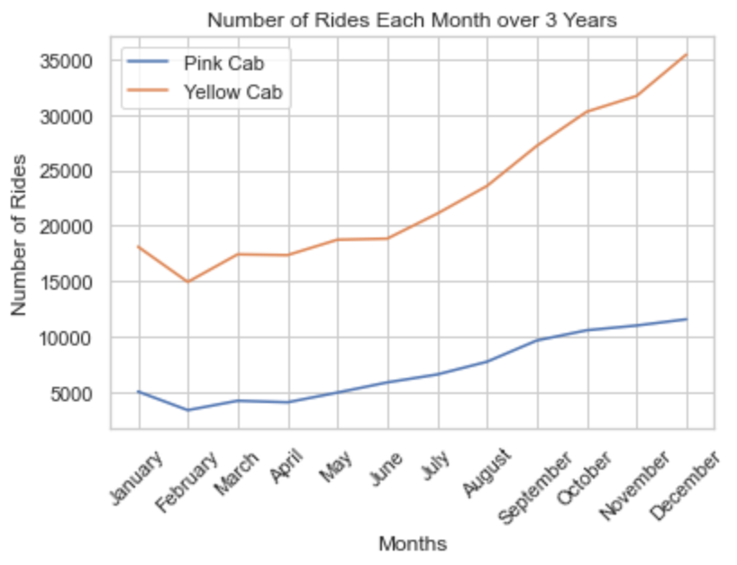
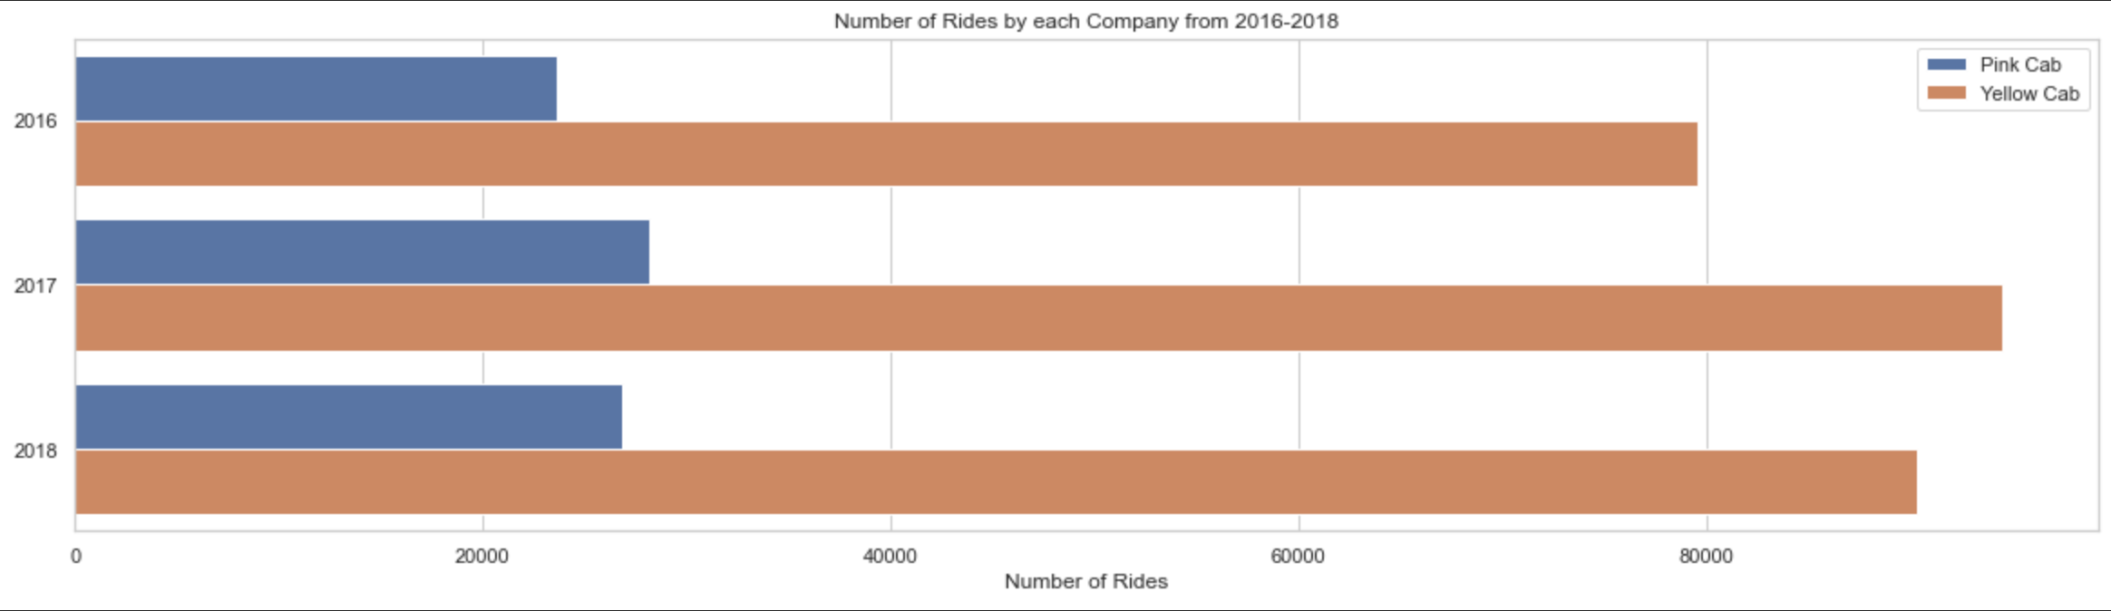
Ride Analysis
It is seen that the Yellow Company has more than double the number of rides each year as compared to the Pink Cab. This trend can be seen continuing in the month wise split of rides. Both the companies have a similar trend of starting off the year with lesser number of rides, but as the year goes on, we see that this number increases to almost 200% of that at the starting of the year.
The main reason for such a trend is more likely to be a customer behaviour pattern rather than company policies. For example, people would want to start the year of healthy and therefore, would prefer walking to taking a cab. As the year goes on, this becomes less important for them, and thus, the number of cab rides increases. The number of rides could depend on a lot more factors.

Slide 8
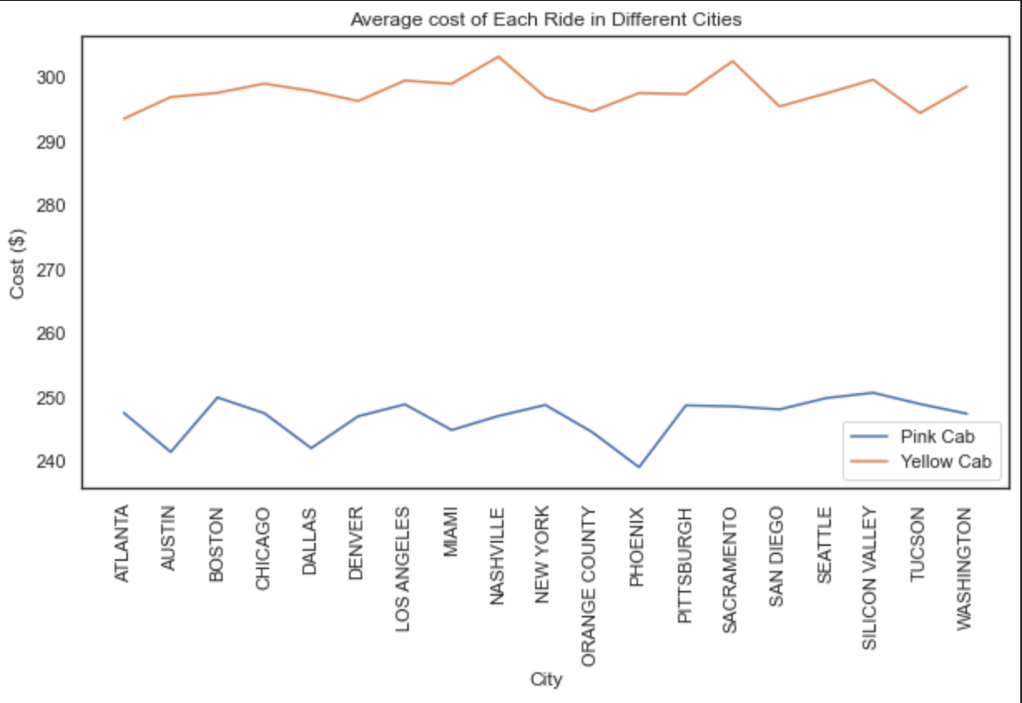
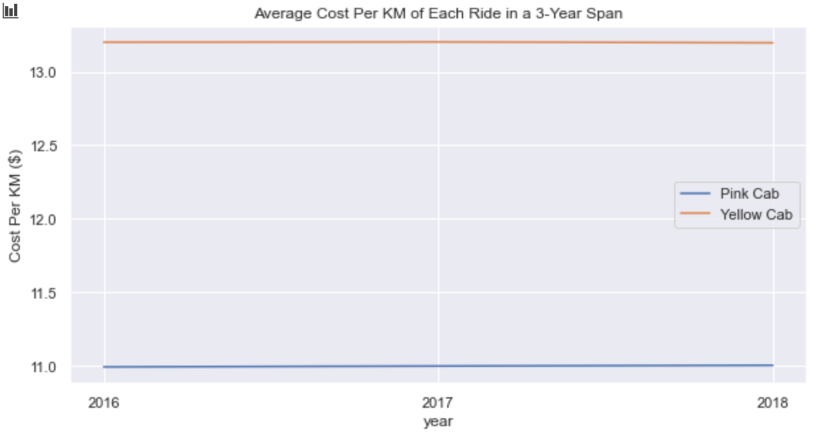
Cost Analysis
As we can see, over the span of 3 years (i.e. 2016-2018), the average cost per km of distance travelled hasn’t changed too much for either company. However, the difference between this cost is almost $2. This could be because of higher quality service offered by the Yellow Company.
The Average cost of each ride in different cities is quite stable, without too large fluctuations in the cost. We can see, however, that the average cost of the Yellow Company exceeds that of the Pink company by almost $45 in all cities.
This could be a matter of concern for them as they are incurring much higher costs for providing the same service as their competitors.

Slide 9
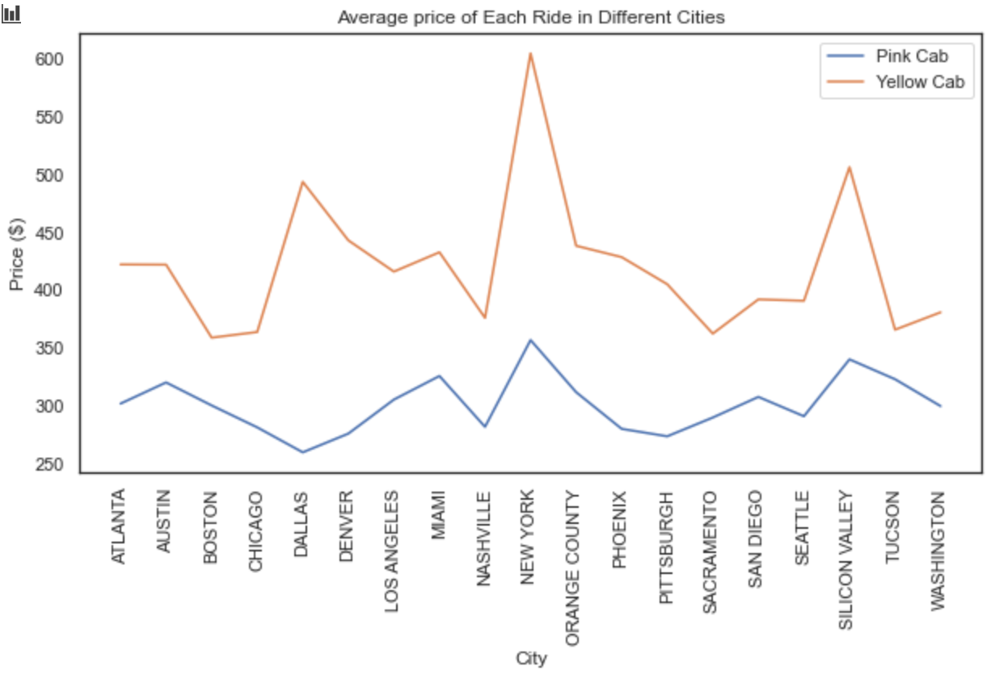
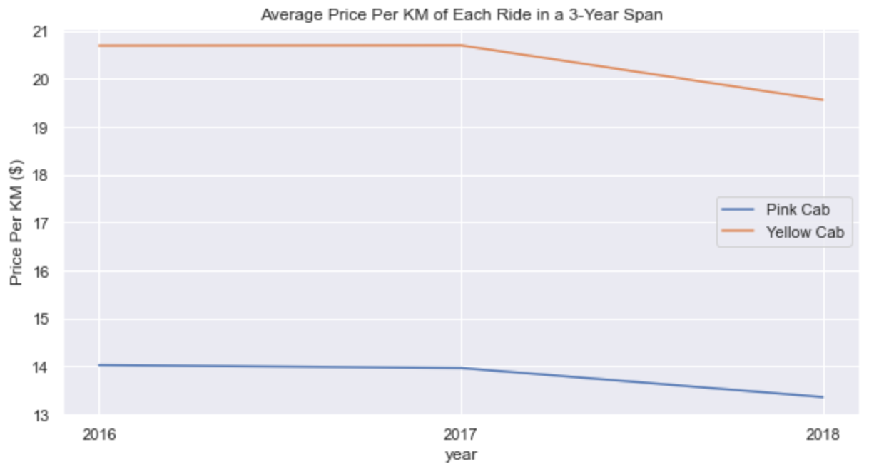
Price Analysis
We observe that the Average price per KM over the 3 years (2016-2018), for both the companies, follows a similar pattern. We see that the price/KM charged by both in 2018 is quite lower than in 2016 and 2017 (where it stayed constant). We also see that the Yellow company charges almost $7/KM higher than the Pink Company.
Next, let us observe the average price of each ride in different cities of operation. We notice that the price is quite varying for both companies, with New York being the most expensive city for cab rides from these 2 companies. We can also see that the Yellow Company has a higher price that they charge their customers.

Slide 10
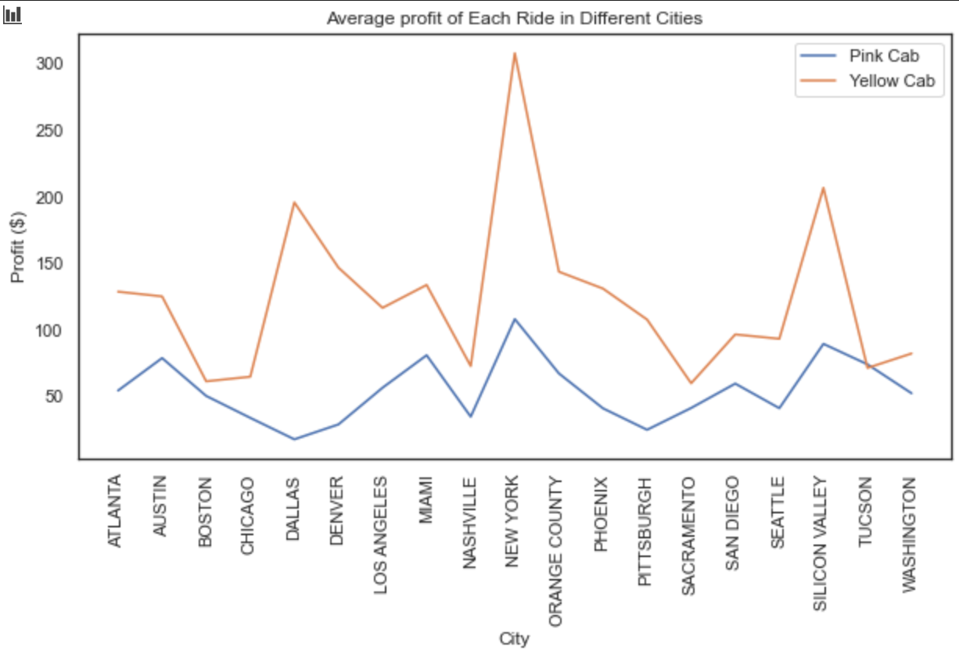
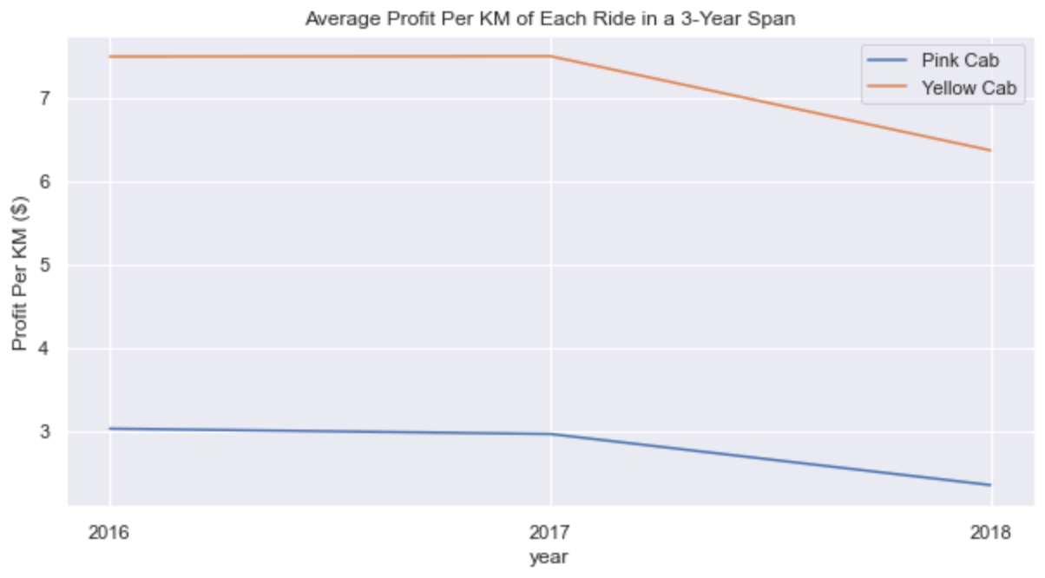
Profit Analysis by City and Year ($/KM)
We see that in the span of 3 years, the profit/KM has decreased in 2018 as compared to 2016 & 2017, which were equal. We have already seen that the average cost/KM remained constant, while the price/KM decreased. This resulted in such a trend for the profit/KM feature.
We see that the Average profit in each city plot has a similar shape to the average price inn each city plot. We also observe that the Yellow company has a higher profit in all cities other than Tucson, where the Pink company just edges it out.

Slide 11
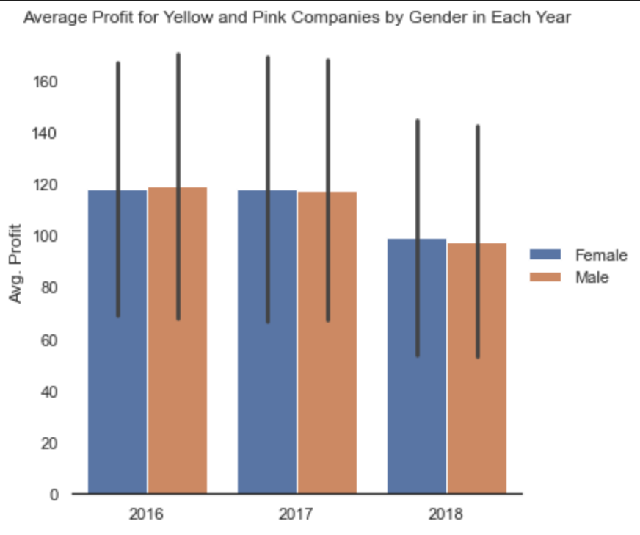
Average Profit by Gender
Here, we can see the average profit figures from each of the years, with male and female passengers counted separately.
We can see that in 2016, the profit generated from male passengers was slightly higher than the female passengers while in 2017 & 2018, it was the other way around, with female passengers generating a higher average profit than male passengers. This number, however, is almost negligible.

Slide 12
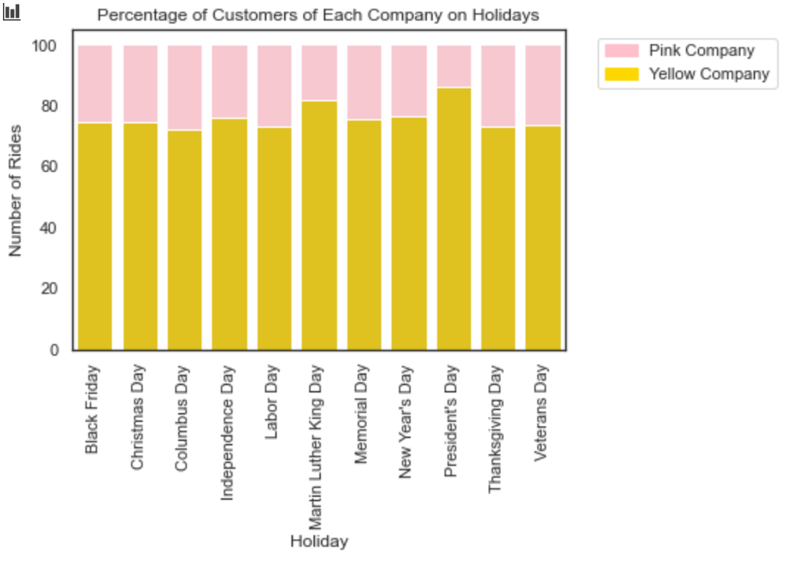
Customer Preferences on Holidays
Here, we see a bar chart, showing us the percentage of users who chose a particular cab on US Federal Holidays.
We can see that almost 70-75% of the rides on Holidays are done by the Yellow company.
This could be a huge strength as having such a high market share shows true ability and potential.

Slide 13
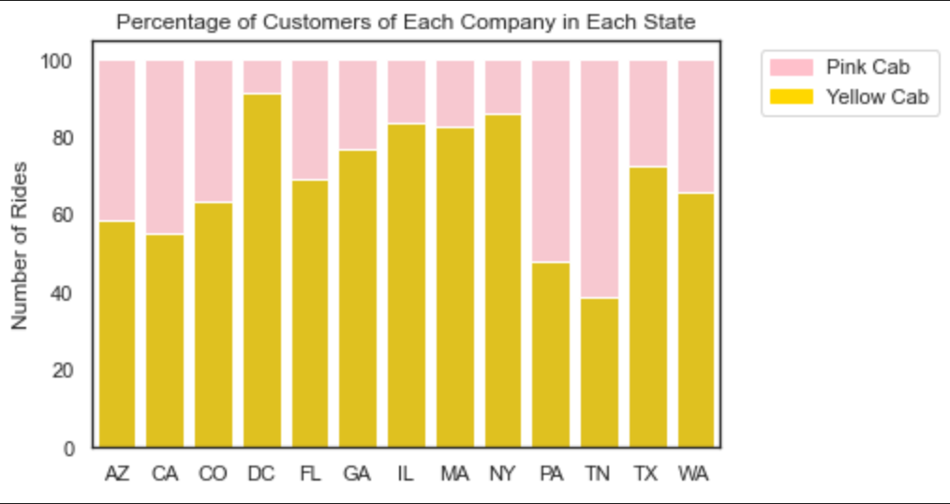
Customer Preference by State
Here, we see the percentage of customers who rode in each of the cabs in each state.
It is observed that the Yellow company has more than 50% of the rides in most states, excepting only Tennessee and Pennsylvania, which have a slightly higher or almost equal percentage of Pink Company rides.

Slide 14
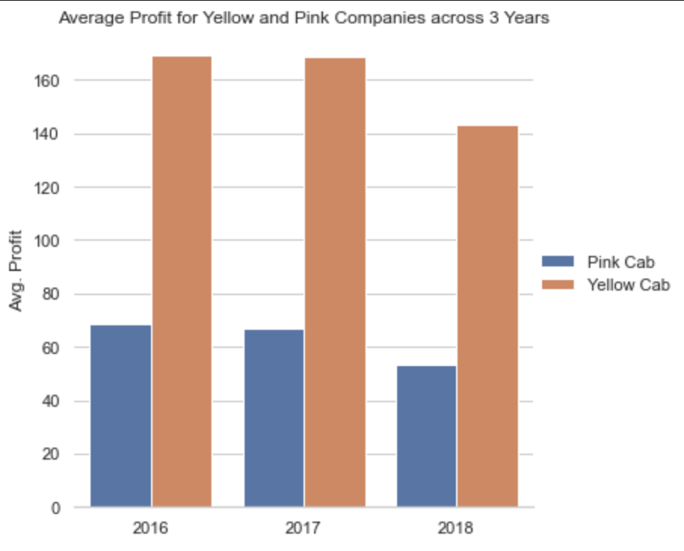
Average Profit by Year
Finally, we see the average profit earned by each company in each of the 3 years.
We see that the Yellow company has a very high average profit compared to the Pink company, exceeding it by almost $95/ride.
This is quite strange and surprising, since their average cost was much higher than that of the Pink company.

Slide 15
Exploratory Data Analysis (EDA) Summary
After going through the plots, we see that the Yellow company has a higher cost per ride, higher price per ride and higher profit per ride. A higher price might lead us to the conclusion that it is the unpopular choice.
This, however, isn’t the case at all. In 11 out of 13 states, majority of rides were done by the Yellow company. It is also the preferred cab out of the 2 on all Federal US Holidays.
At the beginning of the analysis, the significantly higher average cost per ride of the Yellow company was a bit concerning. But now, this isn’t a concern anymore. The higher cost per ride could be attributed to many factors such as Premium Cars used, better maintenance of the vehicles and higher wages for the drivers.

Slide 16
Recommendations
NOTE: This recommendation is only based on profit and cost analysis. A final decision cannot be taken before looking at each of their Financial Statements to ensure that XYZ is investing in the right company.
After seeing the trends that the data showed us, we can clearly say that the Yellow Company is the right choice for XYZ to make an investment as part of their Go-to-Market (G2M) strategy.
We see that the Yellow Company has a higher average profit compared to the Pink company. Not only this, but they also undertake a significantly greater number of rides than the Pink company.
Apart from this, we also know that they are the go-to cab in the market at this point and with additional investment and guidance, could improve their reputation to hold a monopoly over the Cab Industry.

Slide 17
Thank You

